Slide 1
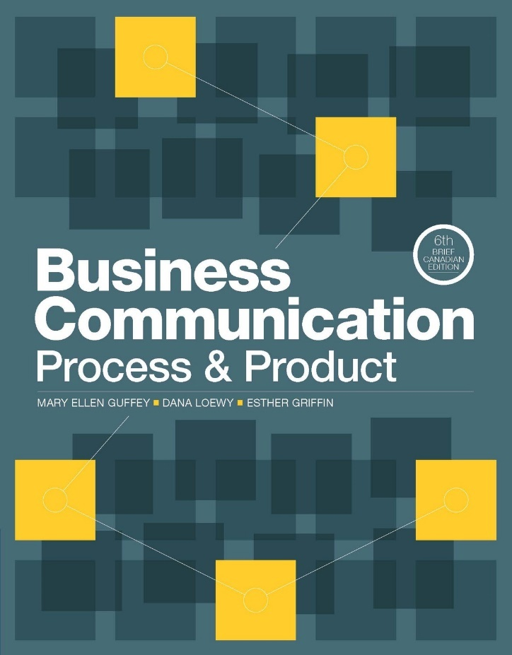
NETA PowerPoint® Slides
to Accompany
Prepared by
Katharine Ferguson,
Seneca College

Slide 2
Business Communication in the Digital Age
Chapter 1

Slide 3
Unit 1 Employability Skills
Fundamental Skills
Communicate
Manage Information
Think and Solve Problems
Personal Management Skills
Demonstrate Positive Attitudes and Behaviours
Be Responsible
Be Adaptable
Learn Continuously
Teamwork Skills
Work With Others
Participate in Projects and Tasks
Notes:
The Conference Board of Canada has determined the employability skills required in the workplace: “Employability Skills 2000+ are the employability skills, attitudes, and behaviours you need to participate and progress in today’s dynamic world of work.” The textbook gives special attention to writing skills because they are difficult to develop and increasingly significant in e-communication.
Source: Conference Board of Canada. (2016). Employability Skills 2000+. Retrieved from http://www.conferenceboard.ca/spse/employability-skills.aspx

Slide 4
Business Communication in the Digital Age
Communication skills
for career success
Importance of
critical thinking
Trends and
technologies
in the workplace
Effective
communication
and typical barriers
Ethical business communication
Notes:
This chapter discusses the skills required to fuel career success, the tools for success in the hyperconnected 21st-century workplace, the trends and technologies in today’s dynamic work environment, the nature of communication and its barriers, the flow of communication in organizations and the importance of making effective media choices, the ethical considerations for business communication, and the tools for doing the right thing.

Slide 5
Communicating in the Digital World
Individuals can expect to work in a fast-paced, competitive, and highly connected digital environment.
Technology connects individuals anywhere and anytime.
Businesses recognize the power of digital media networks.
Electronic media have empowered the public to participate and be heard.

Slide 6
Communicating in the Digital World: Your Path to Success
Strong communication skills
Are critical to effective job placement, advancement, and organizational success
Are specifically asked for in job advertisements
Include general communication, interpersonal skills, and teamwork skills
Are as important as technical skills for entry-level and management positions
Notes:
Good communication skills are critical to job placement, performance, career advancement, and organizational success. When competition is keen, job candidates with exceptional communication skills immediately stand out.

Slide 7
Communication Skills
Include general communication skills, interpersonal skills, and teamwork skills
Require good writing skills
Require individuals to be media savvy and exercise good judgment when posting Internet messages and writing e-mails
Necessitate that individuals guard their online image and protect the reputation of their employers
Notes:
Employers look for general communication skills (especially good writing skills), interpersonal skills, and teamwork skills. They also expect individuals to be able to use technology to stay connected through spoken and written messages, because many people work together but are not in the same location. This is an important lesson for students. Many are naive about the need for good communication skills in a digital world and do not place enough importance on the last point: the need to guard their online images and reputations.

Slide 8
How Good Are Your Communication Skills?
www.mindtools.com/pages/article/newCS_99.htm
Notes:
Have students complete the communication quiz (at www.mindtools.com/pages/article/newCS_99.htm) if your students have access to computers in the classroom. If they do not have access in the classroom, have them complete the quiz at home and e-mail their scores to you. Then discuss the results with them and ask them how they can improve their skills.

Slide 9
“Writing matters more than ever because the online media require more of it, not less.”
Notes:
Thriving in the challenging work world depends on many factors, especially your ability to communicate. Ask students whether they agree or disagree with this statement and have them explain their answer.
Source: Canavor, N. (2012). Business writing in the digital age. Los Angeles: Sage, pp. 1–3. See also National Writing Project with DeVoss, D. N., Eidman-Aadahl, E., & Hicks, T. (2010). Because digital writing matters. San Francisco: Jossey-Bass, pp. 1–5.

Slide 10
Writing in the Digital Age
Writing matters more than ever because of the need to use online media.
Solid writing skills are necessary in a networked digital world.
Most employees write their own messages.
Employees need a broad range of skills and high levels of knowledge in their fields.

Slide 11
Success in the 21st-Century Workplace
The 21st-century economy depends mainly on information and knowledge.
Knowledge workers get paid for their education and ability to learn.
Employers are looking for people with advanced computer skills.
Continuous, lifelong learning will make you more competitive and valuable to employers.
Notes:
The term “knowledge workers” was coined by Peter Drucker. Drucker, P. (1989, May). New realities, new ways of managing. Business Monthly, pp. 50–51. Ask students to provide examples of “knowledge” jobs. As students what is meant by “continuous, lifelong learning.”

Slide 12
Why Should You Care?
You will be expected to
Generate, process, and exchange information
Transmit information effectively across communication channels and multiple media
Make sound decisions and solve complex problems

Slide 13
Why Should You Care?
Technology enables the rapid, frequent transmission of messages.
People stay connected through spoken and written messages.
People with good communication skills are seen as intelligent, educated, and capable.
The ability to write well opens doors to professional employment.

Slide 14
Thinking Critically in the Digital Age
Explore the Challenge
Generate Ideas
Implement Solutions
Identify the challenge
Come up with many ideas
Select and strengthen solutions
Gather information and clarify the problem
Pick the most promising idea
Plan how to implement the solution
Notes:
Thinking critically means having opinions that are backed by reasons and evidence. The Osborn-Parnes creative problem-solving process has three points to help students think critically and solve problems competently. Understanding the problem is essential and is the first step. Generating and selecting the most feasible ideas is the intermediate step. Finally, the problem-solving model prompts students to refine, justify, and implement the solution. Students could be asked in groups of two or three to identify a problem, generate some ideas to solve the problem, and suggest a way to implement the solution.
It is more important than ever for students to be proactive and control their careers.
Discuss career aspirations and how students are preparing for their futures. Include a focus on their job expectations (salary, security, workplace venue, and working hours) after graduation.
Students should understand that employees must have the required skills, course work, and GPA expected. Employers want to hire people with strong communication skills, a good work ethic, the ability to work in teams, and initiative.

Slide 15
Managing Your Career Well
www.youtube.com/watch?v=hqezbib5qpQ
Notes:
Social media has influenced the way we communicate. Before showing the video, have students identify how they use social media for personal branding. Ask them to identify how Facebook, LinkedIn, Instagram, Snapchat, Twitter, etc., can help or hinder a career.

Slide 16
Guarding Your Credibility
Be proactive and exercise control over your career.
Don’t expect 9-to-5 jobs, predictable pay increases, lifetime security, or conventional workplaces.
Expect to work for several employers.
Be willing to continually learn new skills and technologies.
Manage and guard your reputation.
Notes:
How you present yourself in the virtual world, meaning how well you communicate and protect your “brand,” may very well determine how successful your career will be. Thoughtful blog posts, well-crafted messages on social media, and competent e-mails will help make a positive impression (p. 1-11).

Slide 17
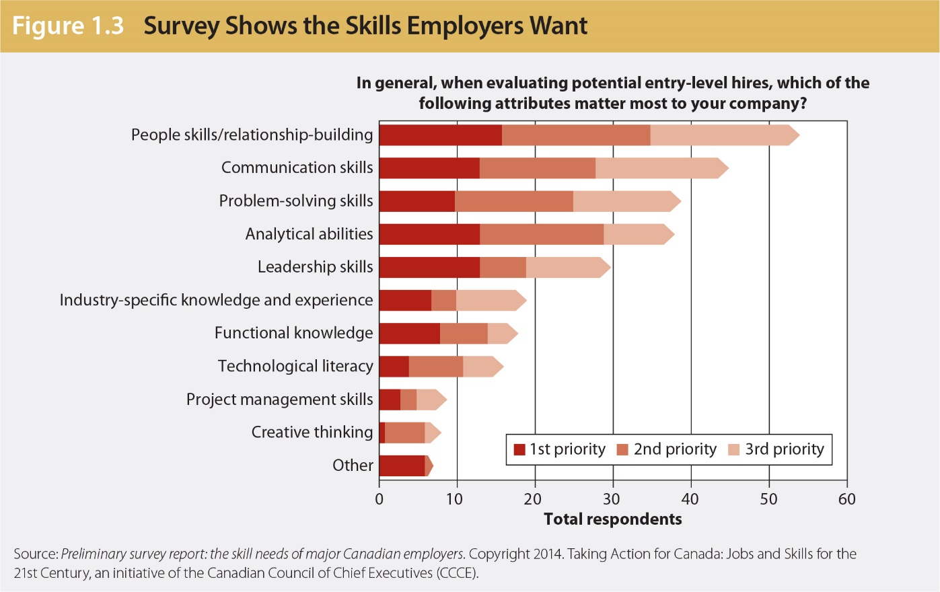
Succeeding in a Competitive Job Market
The bar graph shows the attributes employers want in entry-level hires.
Notes:
Students like to see data, and this graph provides proof of what employers look for in a new hire. Telling students isn’t enough.
Source: Preliminary survey report: the skill needs of major Canadian employers. Copyright 2014. Taking Action for Canada: Jobs and Skills for the 21st Century, an initiative of the Canadian Council of Chief Executives.

Slide 18
Trends and Challenges in the Information Age Workplace
New communication technologies
Expectation of around-the-clock availability
Global competition
Flattened management hierarchies
Team-based projects
Diverse workforce
Mobile or virtual office

Slide 19
Social Media Growth
In 2016
WhatsApp had one billion users
Facebook had on average 1.13 billion daily active users
Twitter had 313 million active users
59% of Canadians visited Facebook each day
30% visited LinkedIn and Twitter
Notes:
Sources:
WhatsApp Blog. (2016). One billion. [Blog post]. Retrieved from https://blog.whatsapp.com/one-billion
Facebook. (2016). Newsroom. Retrieved from http://newsroom.fb.com/company-info/
Twitter. (2016). What’s happening. Retrieved from https://about.twitter.com/company
Groff, A. (2015, September 4). Social media benefiting business owner and consumer. Canada Business Review. Retrieved from www.businessreviewcanada,ca/marketing/1507/Social-media-benefiting-business-owner-and-consumer

Slide 20
Social Media and Changing Communication Technologies
Anytime, anywhere: 24/7/365 availability
Global marketplace and competition
Shrinking management layers
Collaborative environments and teaming
Growing workforce diversity
Virtual and nonterritorial offices
Notes:
Doing business in other countries means dealing with people who may practise different religions, follow different customs, have different lifestyles, and use different approaches to business. If you are discussing globalization and communication in foreign countries and your classroom has students from other countries, ask for volunteers to name differences in communication in their home countries.
Difficulties include different time zones, vast distances between offices, and different languages. New skills required include cultural awareness, flexibility, and patience.
Frontline employees, as well as managers, participate in critical thinking and decision making. Nearly everyone is a writer and a communicator.
Ask students whether they can think of any jobs where they will NOT have to write to or communicate with others.
It is important to discuss social media with students here. Ask students how many have Facebook, LinkedIn, or other social networking accounts. Have they ever posted anything on YouTube? Do they skype, tweet, or use Instagram? How would they feel if their potential employers saw their posts? Is there anything embarrassing on their accounts?

Slide 21
Communication Process
Feedback returns to sender
Receiver decodes the message
Sender selects the channel and transmits
Sender encodes the message
Sender has an idea
Notes:
Initiate class discussion about the meaning of each step and what could go wrong with the message if any step is incorrect.

Slide 22
Barriers That Create Misunderstanding
Bypassing: people miss each other with their meanings
Differing frames of reference: formed by a combination of experiences, education, culture, expectations, and personality
Lack of language skills: oral and written
Distractions: physical distractions and emotional interference
Notes:
Bypassing: miscommunication when people use common but vague words, such as probably, always, never, usually, often, soon, and right away. What do these words really mean?
Differing frames of reference: people bring their biases and expectations to any communication situation.
Lack of language skills: oral and written; using unfamiliar words, jargon, and unrecognizable abbreviations can seriously impede the transmission of meaning.
Distractions:
Emotional interference: shaping an intelligent message is difficult when the sender is feeling joy, fear, resentment, hostility, sadness, or some other strong emotion.
Physical distractions: bad acoustics, noisy surroundings, and poor cell phone connections can disrupt oral communication. Sloppiness, poor printing, careless formatting, and typographical or spelling errors can disrupt written messages.

Slide 23
Overcoming Communication Obstacles
Consider questions like, How is the individual likely to react to my message?
Arrange ideas logically and use precise words.
Ask, Do you have any questions? And then paraphrase, if necessary.
Provide access in written message—include a phone number.
Listen and provide feedback that describes rather than evaluates.

Slide 24
Business Communication Functions
Functions of business communication:
To inform
To persuade
To promote goodwill
Notes:
This is a good time to ask students for examples of situations in which these functions can be used. It is especially important to discuss promoting goodwill, which is something new to most students.

Slide 25
Internal and External Communication
Two basic forms of communication: oral and written
Internal communication includes exchanging ideas and messages with superiors, coworkers, and subordinates, probably by using e-mail.
External communication includes communicating with customers, suppliers, the government, and the public, often by using e-mail.

Slide 26
Communication Advantages
Oral
Written
Gives opportunities to ask questions immediately for clarification
Enables communicators to see facial expressions and hear voice inflections
Is an efficient method to develop consensus when many people are involved
Promotes friendships
Provides a permanent record
Enables communicators to develop an organized, well-considered message
Is convenient
Can be composed and read when the schedules of both communicators permit
Can be reviewed

Slide 27
Communication Disadvantages
Oral
Produces no written record
Sometimes wastes time
May be inconvenient
Requires work interruption
Written
Requires careful preparation
Can become dangerous if made public—“smoking guns” in court cases
Is more difficult to prepare

Slide 28
Media Richness and Social Presence
The more helpful cues and immediate feedback the medium provides, the richer it is.
Face-to-face communication and telephone calls are best to deal with complex problems.
Written communication has lower richness for routine, unambiguous issues.
The degree to which people are engaged online and ready to connect with others is called social presence.
Notes:
Media with high social presence convey warmth and are personal. Social presence is greatest face to face and less so in mediated and written communication, such as phone conversations and text messages. Social presence is also greater in synchronous communication (live chat, IM) than asynchronous communication (e-mail, forum post) that is rather impersonal. Social presence means how much awareness of the sender is conveyed along with the message.
In face-to-face communication, we receive more signals than just speech; for example, nonverbal cues, emotional disposition, and voice inflection help us to interpret a message correctly.

Slide 29
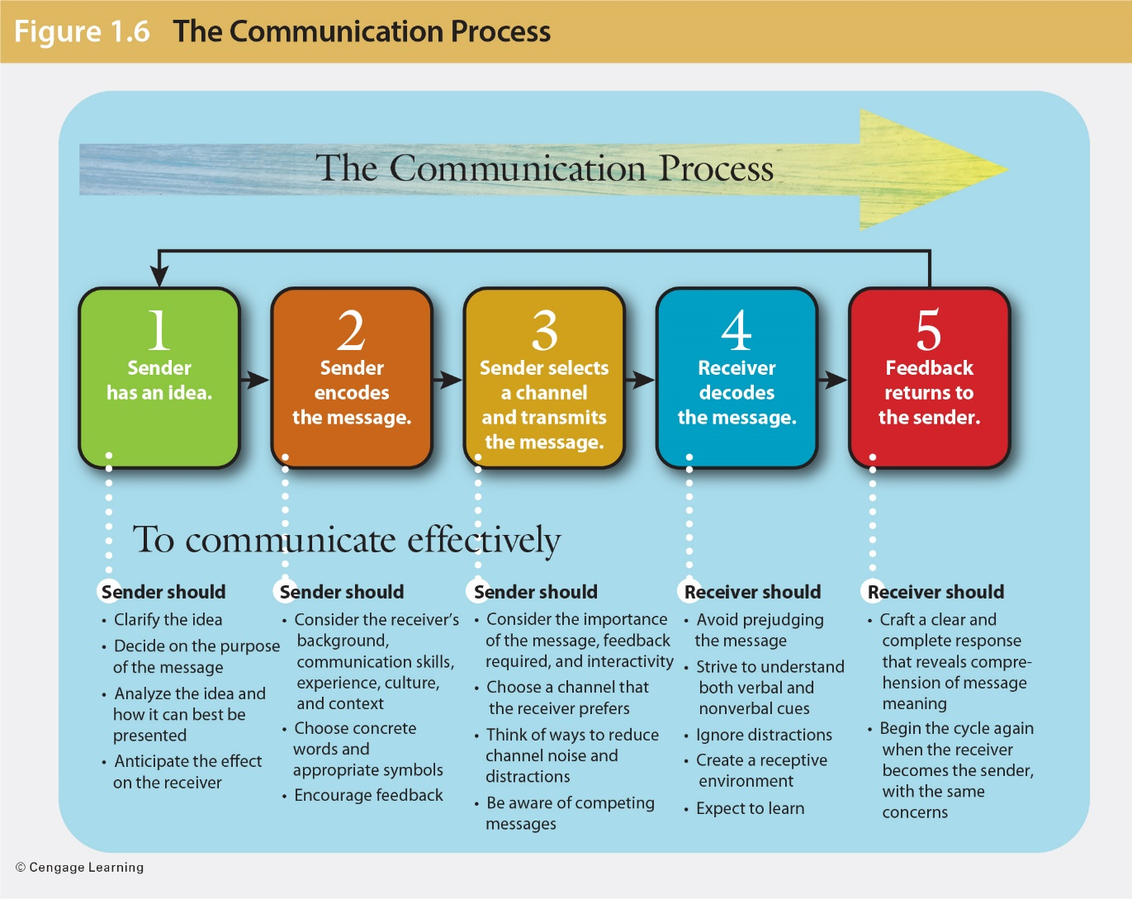
Media Richness and Communication Effectiveness

Slide 30
Information Flow in Organizations: Formal Channels
Managers
Supervisors
Upward flow
Horizontal flow
Coworkers
Coworkers
Downward flow
Subordinates
Supervisees
Notes:
A free exchange of information helps organizations respond rapidly to changing markets, boost efficiency and productivity, build employee morale, serve the public, and take full advantage of the ideas of today’s knowledge workers. Formal channels of communication generally follow an organization’s command hierarchy.

Slide 31
Information Flow in Organizations: Formal Channels
Managers
Supervisors
Job plans
Policies
Motivation
Procedures
Flow from
decision makers
to workers
Downward
Subordinates
Supervisees
Notes:
Information flowing downward generally moves from decision makers, including CEOs and top managers, through the chain of command to workers.
Longer lines of communication can distort the message. To improve communication, management speaks directly to team leaders, thus speeding up the process. Management also uses newsletters, announcements, meetings, videos, blogs, podcasts, and company intranets. It is important to let workers know how well the company is doing and what new projects are planned.

Slide 32
Improving Downward Information Flow
Companies create smaller operating units and work teams.
Management speaks directly to employees.
Companies use company publications, announcements, meetings, videos, podcasts, and other channels to let workers know how well the company is doing and what new projects are planned.

Slide 33
Information Flow in Organizations: Formal Channels
Managers
Supervisors
Feedback
Progress
Problems
Suggestions
Flow from
employees to
decision makers
Upward
Subordinates
Supervisees
Notes:
Feedback from employees forms the upward flow of communication in most organizations. Ideally, the heaviest flow of information should be upward, with information being steadily fed to decision makers.
Obstacles to such communication include distrust, downsizing, cost-cutting measures, use of temporary workers, discrimination and harassment suits, outsourcing, etc. These lessen the trust employees feel for their employers and their jobs.
Companies can improve the upward information flow by hiring communication coaches to train employees; having regular staff meetings and incentive programs for information sharing; providing a trusting, nonthreatening environment for employees to comfortably share their observations and ideas with management; setting up hotlines for anonymous feedback to management; and creating an ombudsman program.

Slide 34
Improving Upward Information Flow
Hire communication coaches to train employees.
Ask employees to report customer complaints.
Encourage regular staff meetings.
Provide a nonthreatening environment where employees can share observations and ideas.
Offer incentive programs that encourage valuable employee feedback.

Slide 35
Information Flow in Organizations: Formal Channels
Horizontal flow
Shared information to coordinate
tasks, solve problems, resolve conflict,
build teams
Flow among workers
at the same level
Coworkers
Coworkers
Notes:
Lateral channels transmit information among workers at the same level. They enable individuals to coordinate tasks, share information, solve problems, resolve conflicts, and build teams. Horizontal flow takes place through personal contact, telephone, e-mail, memos, voice mail, and meetings.
Obstacles include poor communication skills, prejudice, ego involvement, turf wars, competition within units, and uneven reward systems.

Slide 36
Improving Horizontal Information Flow
Train employees in teamwork and communication techniques.
Establish a reward system based on team achievement rather than on individual achievement.
Encourage full participation in team functions.
Notes:
Ensure that employees realize that they are personally responsible for making themselves heard, for understanding what other people say, and for getting the information they need .

Slide 37
Informal Communication Channels
The grapevine carries organizationally
relevant gossip.
Functions through social relationships
Carries unofficial messages
Flows haphazardly
Can be remarkably accurate
Is mostly disliked by management
Thrives where official information is limited
Travels much more rapidly online
Notes:
The grapevine is an informal channel of communication that carries organizationally relevant gossip. It is powerful, functioning through social relationships, and it takes place in the office breakroom, at a coworker’s desk, and in e-mails, texts, and blogs.
As much as two thirds of an employee’s information comes from the grapevine, which has demonstrated accuracy ratings of 80 percent or more for many grapevine transmissions.

Slide 38
Using the Grapevine Productively
Respect employees’ desire to know.
Increase the amount of information delivered through formal channels.
Share bad and good news.
Monitor the grapevine using social and digital media.
Act promptly to correct misinformation.
Notes:
Online consumer-generated comments provide a very public glimpse of what employees and customers think. High-profile leaks travel fast, and their accuracy can be verified more easily than can rumours in an offline grapevine. Companies that actively monitor social media are better able to correct inaccuracies and misperceptions.

Slide 39
Respond Ethically to Gossip
Run—don’t walk—away from anyone who starts to gossip.
End rumours about others.
Attack rumours about yourself.
Keep confidences.
Limit the amount of personal information you share.
Avoid any form of coworker belittlement.
Build up coworkers; don’t tear them down.

Slide 40
Ethics in the Workplace Are Needed More Than Ever
What is ethical behaviour?
Conventional standards of right and wrong that prescribe what people
should do
Notes:
Ethics refers to conventional standards of right and wrong that prescribe what people should do. These standards usually consist of rights, obligations, and benefits to society. They include virtues such as fairness, honesty, loyalty, and concern for others. Ethics is about having values, taking responsibility, and following the law.

Slide 41
Defining Ethics
Is conventional standards of right and wrong
Prescribes what people should do
Consists of rights, obligations, and benefits to society
Is about having values and taking responsibility
Is about being expected to follow the law

Slide 42
Doing What Ethical Communicators Do
Abide by the law.
Tell the truth.
Label opinions.
Be objective.
Communicate clearly.
Use inclusive language.
Give credit.
Notes:
Have students research the IABC Code of Ethics for Professional Communicators. Have them come up with unethical situations they may encounter in their future jobs or /careers, and have them identify solutions for doing the right thing.

Slide 43
Choosing Tools for Doing the Right Thing
Is the action you are considering legal?
Would you do it if you were on the opposite side?
Can you rule out a better alternative?
Would a trusted advisor agree?
Would family, friends, or coworkers approve?
Notes:
Resolving ethical questions is not easy. It can be made less difficult when key issues are identified, and these questions can help. Ask students whether they have ever been in a situation where they had to decide whether to act ethically.

Slide 44
Summary of Learning Objectives
Explain how communication skills fuel career success and understand why writing skills are vital in a digital, mobile, and social-media-driven workplace.
Identify the skills for success in the hyperconnected 21st-century workplace, and competitive job market.
Describe significant trends and technologies in today’s dynamic work environment.

Slide 45
Summary of Learning Objectives
Understand the nature of communication and its barriers.
Examine critically the flow of communication in organizations, explain the importance of effective media choices, and understand how to overcome typical barriers to organizational communication.
Analyze ethics in the workplace, understand the goals of ethical business communicators, and choose the tools for doing the right thing.

